Slide 1
Boxify — Customer Churn Analysis
Executive summary and key visuals

Slide 2
Key KPIs
Overall churn rate: 25.80%
Average tenure (months): 17.8
Avg LTV (churned): INR 6,293.14
Avg LTV (active): INR 13,208.18

Slide 3
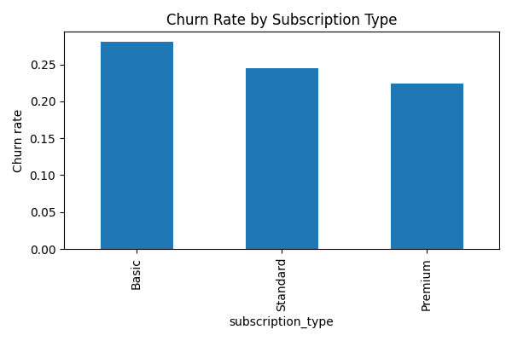
Churn by Subscription

Slide 4
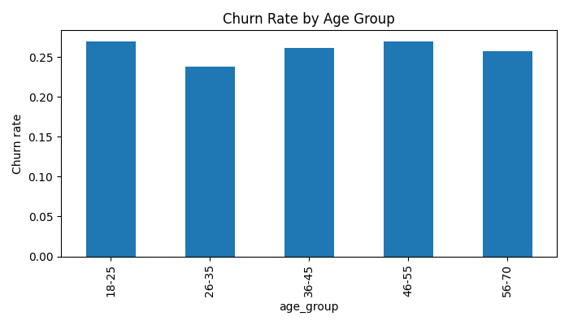
Churn by Age Group

Slide 5
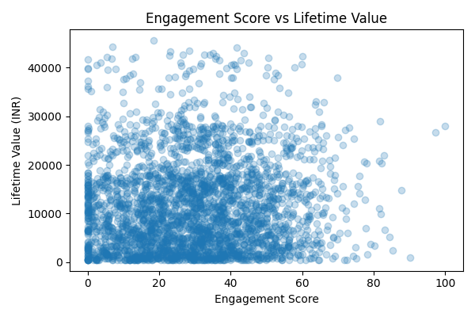
Engagement vs LTV

